Slide 1
SDV Overview
SDV: Software Defined Vehicles

Slide 2
Contents
SDV Overview
1. Contents
2. Definition
3. Driving forces
3.1. ACES (Automated, Connected, Electrified, Shared)
3.2. Centralized Domain Control
3.3. Software Complexity
3.4. The Success of Tesla
4. Technologies
5. Changes
6. Benefits
7. Conclusion
8. References

Slide 3
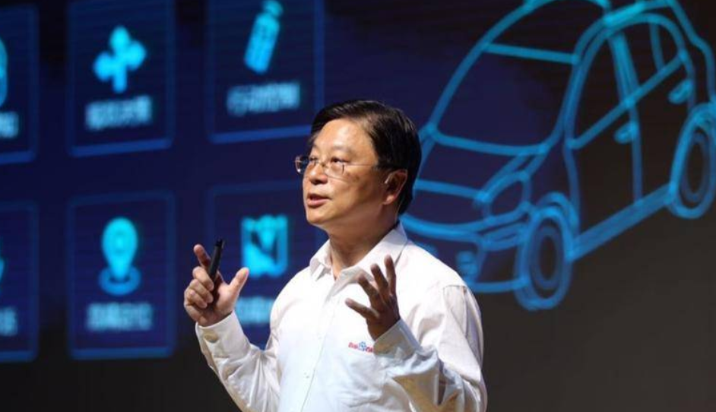
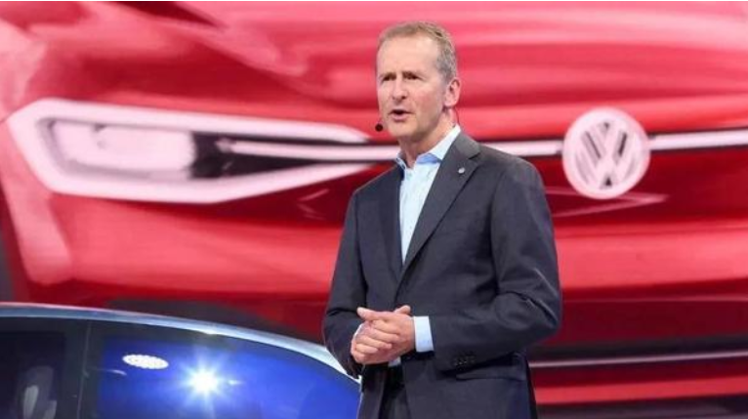
Definition
SDV Overview
SDV (Software-defined vehicles) is a term that describes a vehicle whose features and functions are primarily enabled through software, a result of the ongoing transformation of the automobile from a product that is mainly hardware-based to a software-centric electronic device on wheels^{[1]}.
“Vehicles that dominate the future will be software defined vehicles (SDV) based on artificial intelligence, and the ultimate state would be driverless vehicles^{[11]}.” said Wang Jing, senior VP of Baidu, 2016.
"The car will become the most complex internet device we have known so far, the car will become a software product^{[7]}." said Herbert Diess , Chairman of the Board of Management of Volkswagen Group, 2019.

Slide 4
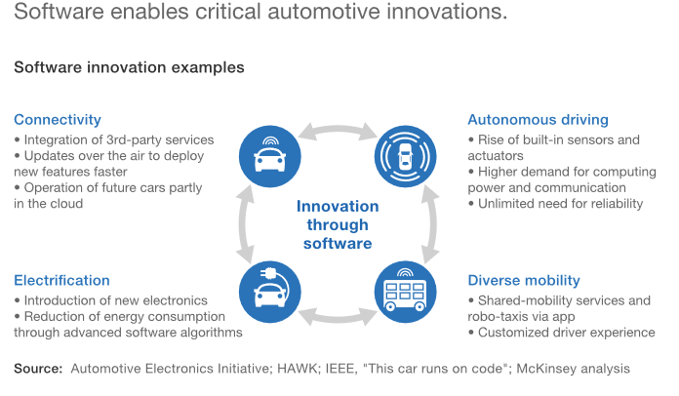
Driving forces: ACES (Automated, Connected, Electrified, Shared)^{[2]}
SDV Overview
Four powerful trends are reshaping customer expectations and driving manufacturers to increasingly turn to software to address them.

Slide 5
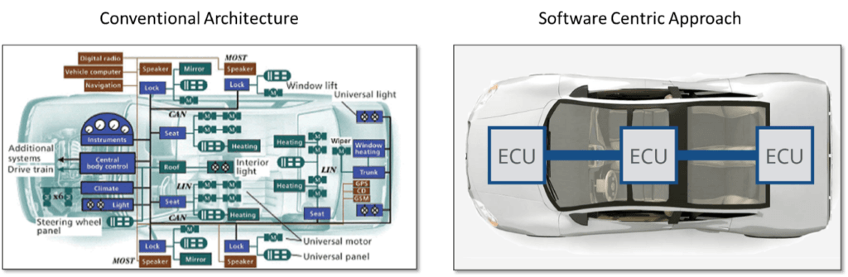
Driving forces: Centralized Domain Control
SDV Overview
While the distributed systems of vehicles have been practical and functional up until now, newer architectures, more data, and a movement toward centralized processing is challenging the limits of traditional automotive design. One such trend is the consolidation of domains into a centralized computer architecture. Instead of having several discrete ECUs, they are all housed in a centralized domain control. This model allows for greater software functionality, more code reuse, and easier remote management^{[3]}.

Slide 6
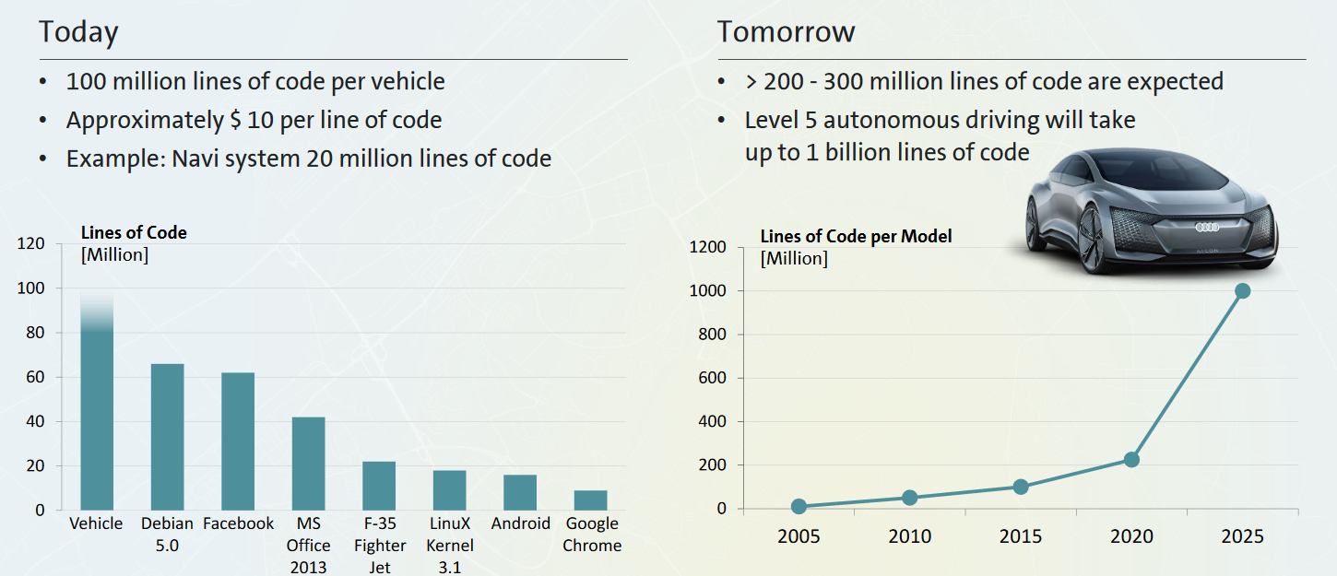
Driving forces: Software Complexity^{[5]}
SDV Overview

Slide 7
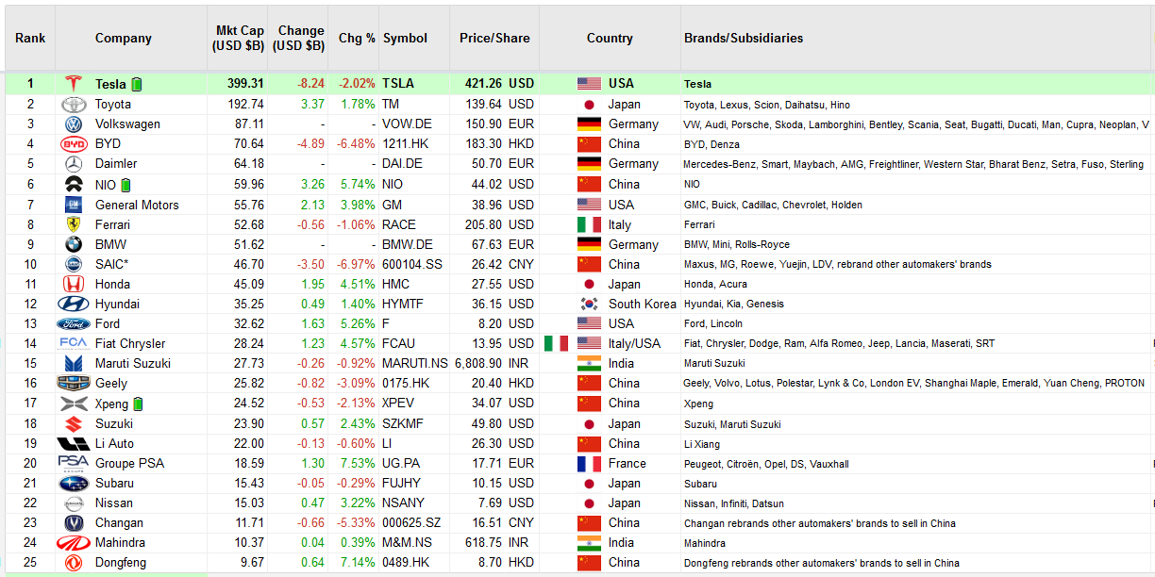
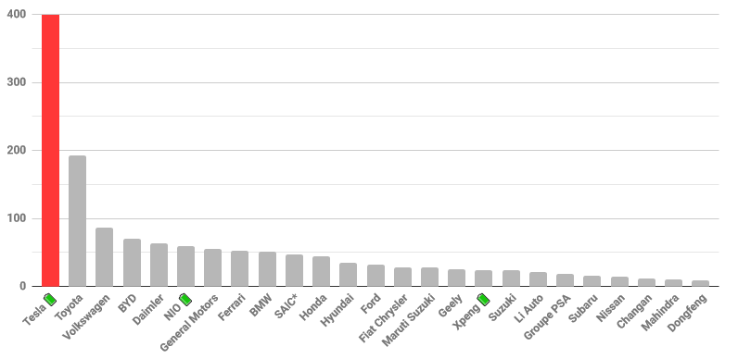
Driving forces: The Success of Tesla^{[8]} The Data is from 24th Nov. 2020
SDV Overview

Slide 8
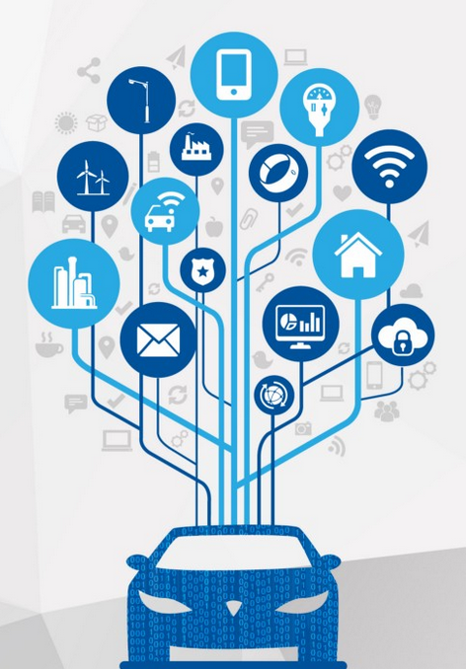
Technologies
SDV Overview
Cloud
Networking
Security
Safety
Operating Systems
Audio
AI
IoT
Computing
Autonomous Self-driving
AutoSAR
Hypervisor
Diagnosis
Graphics
V2X
CCU
HMI
Optical
A2B
Mechanical
Web
P2P
Automotive Ethernet
Navigation
AVB
FM/AM
CAN
Most

Slide 9
Changes
SDV Overview
The separation of software and hardware development.
Agile methodologies will drive continuous software development, and OEMs will be able to deploy software to the vehicle even after it has left the factory.
Computing demands and data from various sensors will increase dramatically
A more modular service-oriented architecture (SOA) model will be adopted in software and electrical and electronic architecture
Security strategies will become even more critical to avoid, detect and defend against cyber attacks, and those strategies will have to evolve to protect the whole system rather than simply protecting individual components or boxes within it.
OEMs start to ramp up software competency and tend to develop and their own software stacks.

Slide 10
Benefits
SDV Overview
Customers will be able to receive over-the-air (OTA) updates that cover security patches, infotainment improvements, plus monitoring and tuning of core functional capabilities of the vehicle, such as power-train and vehicle dynamics.
OEM can lock/unlock new safety, comfort and convenience features on the fly
Giving vehicle manufacturers insight into every aspect of a vehicle, its performance and its place in the connected ecosystem
OEM has opportunity to improve life-cycle management and develop revenue-generating features they can offer to customers
Create new business models and revenue streams such as theft-prevention services, emergency assist alerts, travel guides, on-demand services/features.
In short the software-defined vehicle will create opportunities for OEMs, suppliers, and customers, many of which haven’t even been conceived yet.

Slide 11
Conclusion
SDV Overview
Up to now we can see there are three typical modes to respond to this trend.
Mode | Type | Follower | Aim | Label | Characteristic | Status
Apple mode | Tesla | NIO, Xpeng, VW?, SAIC? | Provide excellent product for end customers | Product | Close product Iterating hardware, software, and services among products Technological advance sensitive | Partial successful
Android mode | Huawei | Baidu?, Banma | Provide powerful and flexible platform for partners | Platform | Close platform and open ecosystem Iterating platform among internal release Ecosystem and user number sensitive | Trying
Design-house mode | Bosch | Aptiv, Joynext, and other traditional Tire1/2 | Provide competitive engineering solutions for OEMs | Project | Open solution Iterating software components and engineering competency among projects Cost and competency sensitive | Ongoing

Slide 12
References
SDV Overview
https://www.aptiv.com/insights/article/what-is-a-software-defined-vehicle
https://www.mckinsey.com/industries/automotive-and-assembly/our-insights/rethinking-car-software-and-electronics-architecture#
https://www.autovision-news.com/hmi/vehicle-control/changes-vehicle-electrical-architecture/
https://auto.sina.com.cn/jishu/2020-09-01/detail-iivhvpwy4212861.shtml
https://www.volkswagenag.com/presence/investorrelation/publications/presentations/2019/03_march/1_CMD_Diess.pdf
https://alltechasia.com/baidu-to-launch-driverless-cars-in-scenic-wuzhen/
https://www.linkedin.com/pulse/car-become-software-product-herbert-diess/
https://docs.google.com/spreadsheets/u/1/d/1HflVng6sYIb6Gs4pOKiDGtqU5YJ2-hgdM4pRNaT62gs/htmlview
http://stock.tianyancha.com/ResearchReport/eastmoney/5348e9b42159c8a0c7c7edcc8b5cdab7.pdf
https://www.vzkoo.com/doc/14690.html?a=1&keyword=%E8%BD%AF%E4%BB%B6%E5%AE%9A%E4%B9%89%E6%B1%BD%E8%BD%A6
https://baike.baidu.com/reference/19670569/5ebfy82gQq8v4Q5FW680VUfH2e8S-edHMG0eT8yGVN7f265ANo9SO1NB0RxAs8G3SKVDk_LEWQp5AXvMAZwUWKsnMSNBZHVznpldTRrSgD0xCpsWThonu8-fBeQ

